Slide 1
Lesson 2
MapReduce Basics

Slide 2
Divide and Conquer
For example, the following are just some of the issues that need to be addressed:
How do we break up a large problem into smaller tasks? More specifically, how do we decompose the problem so that the smaller tasks can be executed in parallel?
How do we assign tasks to workers distributed across a potentially large number of machines (while keeping in mind that some workers are better suited to running some tasks than others, e.g., due to available resources, locality constraints, etc.)?
How do we ensure that the workers get the data they need?
How do we coordinate synchronization among the different workers?
How do we share partial results from one worker that is needed by another?
How do we accomplish all of the above in the face of software errors and hardware faults?

Slide 3
Divide and Conquer
One of the most significant advantages of MapReduce is that it provides an abstraction that hides many system-level details from the programmer. Therefore, a developer can focus on what computations need to be performed, as opposed to how those computations are actually carried out or how to get the data to the processes that depend on them.
MapReduce provides a means to distribute computation without burdening the programmer with the details of distributed computing.
Large-data processing by definition requires bringing data and code together for computation to occur. MapReduce addresses this challenge by providing a simple abstraction for the developer, transparently handling most of the details behind the scenes in a scalable, robust, and efficient manner.
Instead of moving large amounts of data around, it is far more efficient, if possible, to move the code to the data. This is operationally realized by spreading data across the local disks of nodes in a cluster and running processes on nodes that hold the data. The complex task of managing storage in such a processing environment is typically handled by a distributed file system that sits underneath MapReduce.

Slide 4
Functional Programming
MapReduce has its roots in functional programming (eg. ML, LISP)
A key feature of functional languages is the concept of higher order functions, or functions that can accept other functions as arguments.
Two common built-in higher order functions are map and fold.
Given a list, map takes as an argument a function f (that takes a single argument) and applies it to all elements in a list.

Slide 5
Functional Programming
Given a list, fold takes as arguments a function g (that takes two arguments) and an initial value: g is first applied to the initial value and the first item in the list, the result of which is stored in an intermediate variable. This intermediate variable and the next item in the list serve as the arguments to a second application of g, the results of which are stored in the intermediate variable. This process repeats until all items in the list have been consumed; fold then returns the final value of the intermediate variable.
Typically, map and fold are used in combination.

Slide 6
Sum of squares
For example, to compute the sum of squares of a list of integers,
one could map a function that squares its argument (that is, f(x) = x²) over the input list,
{2, 7, 9} {4, 49, 81}
and then fold the resulting list with the addition function (more precisely, g(x, y) = x + y ) using an initial value of zero.
{4, 49, 81} 134
( 0 + 4 = 4, 4 + 49 = 53, 53 + 81 = 134)
Map(f)
Fold(g, 0)

Slide 7
Map and Fold
f
f
f
f
f
Second argument of g
g
g
g
g
g
1st argument of g
Initial value
Final value

Slide 8
Another Example of Map and Fold
Write a Map and Fold Algorithm to classify an array into three different category.
Has more even numbers
Has more odd numbers
Has equal number of even and odd numbers

Slide 9
Solution
Part 1: pseudo code for f.
int f(x)
{ return (x % 2 == 0) ? 1 : -1; }
Part 2: pseudo code for g.
int g(x, y)
{ return x + y; }
Part 3: Specification of initial value.
Initial value = 0
Part 4: Interpretation of final value.
+ integer : more evens, - integer: more odds, 0: equal

Slide 10
Another Example of Map and Fold
A wave array is defined to an array which does not contain two even numbers or two odd numbers in adjacent locations.
{7, 2, 9, 10, 5}, {4, 11, 12, 1, 6}, {1, 0, 5},{2} are all wave arrays.
{2, 6, 3, 4} is not a wave array because the even numbers 2 and 6 are adjacent to each other.
{3, 4, 9, 11, 8} is not a wave array because the odd numbers 9 and 11 are adjacent to each other.
You can assume array has at least one element.

Slide 11
State Diagram : isWave
All states other than initial state is final.
Last item odd (even) : Wave
Last item was even
Found even
Found even
Found even or odd
IInitial State
Found odd
Found even
Not a Wave
Found odd
Last item was odd
Found odd

Slide 12
State Diagram : isWave
All states other than initial state is final.
Last item odd (even) : Wave
2
2
2
2
2, 3
I1
0
3
3
3
3

Slide 13
Solution
Part 1: pseudo code for f.
int f(x)
{ return (x % 2) + 2 ; }
Part 2: pseudo code for g.
int g(x, y)
{ if (x == 0 || x == y) return 0;
return y; }
Part 3: Specification of initial value.
Initial value = 1
Part 4: Interpretation of final value.
0: not a wave 2,3 : wave

Slide 14
Observations
We can view map as a concise way to represent the transformation of a dataset (as defined by the function f).
We can view fold as an aggregation operation, as defined by the function g.
One immediate observation is that the application of f to each item in a list (or more generally, to elements in a large dataset) can be parallelized in a straightforward manner, since each functional application happens in isolation. In a cluster, these operations can be distributed across many different machines.
The fold operation, on the other hand, has more restrictions on data locality. Elements in the list must be brought together before the function g can be applied.

Slide 15
Mappers and Reducers
Key-value pairs form the basic data structure in MapReduce. Keys and values may be primitives such as integers, floating point values, strings, and raw bytes, or they may be arbitrarily complex structures (lists, tuples, associative arrays, etc.). Programmers typically need to define their own custom data types.
In MapReduce, the programmer defines a mapper and a reducer with the following signatures:
map: (k1; v1) [(k2; v2)]
reduce: (k2; [v2]) [(k3; v3)]

Slide 16
Mappers and Reducers
The input to a MapReduce job starts as data stored on the underlying distributed file system. The mapper is applied to every input key-value pair (split across an arbitrary number of files) to generate an arbitrary number of intermediate key-value pairs.
The reducer is applied to all values associated with the same intermediate key to generate output key-value pairs.
Implicit between the map and reduce phases is a distributed “group by" operation on intermediate keys.

Slide 17
Mappers and Reducers
Intermediate data arrive at each reducer in order, sorted by the key.
However, no ordering relationship is guaranteed for keys across different reducers.
Output key-value pairs from each reducer are written persistently back onto the distributed file system (whereas intermediate key-value pairs are transient and not preserved).
The output ends up in r files on the distributed file system, where r is the number of reducers.
For the most part, there is no need to consolidate reducer output, since the r files often serve as input to yet another MapReduce job.

Slide 18
Word count algorithm
class Mapper
method Map(docid a; doc d)
for all term t in doc d do
Emit(term t; count 1)
class Reducer
method Reduce(term t; counts [c1; c2; …])
sum = 0
for all count c in counts [c1; c2; …] do
sum = sum + c
Emit(term t; count sum)

Slide 19
Word count algorithm
This algorithm counts the number of occurrences of every word in a text collection, which may be the first step in, for example, building a unigram language model (i.e., probability distribution over words in a collection).
Input key-values pairs take the form of (docid, doc) pairs stored on the distributed file system, where the former is a unique identifier for the document, and the latter is the text of the document itself.

Slide 20
Word count algorithm
The mapper takes an input key-value pair, tokenizes the document, and emits an intermediate key-value pair for every word: the word itself serves as the key, and the integer one serves as the value (denoting that we've seen the word once).
The MapReduce execution framework guarantees that all values associated with the same key are brought together in the reducer. Therefore, in our word count algorithm, we simply need to sum up all counts (ones) associated with each word.

Slide 21
Word count algorithm
The reducer does exactly this, and emits final key-value pairs with the word as the key, and the count as the value. Final output is written to the distributed file system, one file per reducer.
Words within each file will be sorted by alphabetical order, and each file will contain roughly the same number of words.
The partitioner controls the assignment of words to reducers.
The output can be examined by the programmer or used as input to another MapReduce program.

Slide 22
Hadoop vs. Google
In Hadoop, the reducer is presented with a key and an iterator over all values associated with the particular key. The values are arbitrarily ordered.
Google's implementation allows the programmer to specify a secondary sort key for ordering the values (if desired) in which case values associated with each key would be presented to the developer's reduce code in sorted order.
In Google's implementation the programmer is not allowed to change the key in the reducer. That is, the reducer output key must be exactly the same as the reducer input key.
In Hadoop, there is no such restriction, and the reducer can emit an arbitrary number of output key-value pairs (with different keys).

Slide 23
Mappers and Reducers
Mappers and reducers are objects that implement the Map and Reduce methods, respectively. In Hadoop, a mapper object is created for each map task associated with an input split and the map method is called on each key-value pair in the input split by the execution framework. In a MapReduce job, the programmer provides a hint on the number of map tasks to run, but the execution framework makes the final determination based on the physical layout of the data.
The situation is similar for the reduce phase: a reducer object is initialized for each reduce task, and the Reduce method is called once per intermediate key. In contrast with the number of map tasks, the programmer can precisely specify the number of reduce tasks.

Slide 24
Restrictions on Mappers and Reducers
Mappers and reducers can express arbitrary computations over their inputs. However, one must generally be careful about use of external resources since multiple mappers or reducers may be contending for those resources. For example, it may be unwise for a mapper to query an external SQL database.
Mappers can emit an arbitrary number of intermediate key-value pairs, and they need not be of the same type as the input key-value pairs. Similarly, reducers can emit an arbitrary number of final key-value pairs, and they can differ in type from the intermediate key-value pairs.

Slide 25
Side effects
Mappers and reducers can have side effects. It may be useful for mappers or reducers to have external side effects, such as writing files to the distributed file system. Since many mappers and reducers are run in parallel, and the distributed file system is a shared global resource, special care must be taken to ensure that such operations avoid synchronization conflicts. One strategy is to write a temporary file that is renamed upon successful completion of the mapper or reducer.

Slide 26
Special cases
Case 1. MapReduce programs can contain no reducers, in which case mapper output is directly written to disk (one file per mapper). Example problems: parse a large text collection or independently analyze a large number of images.
Case 2. MapReduce program with no mappers is not possible, although in some cases it is useful for the mapper to implement
the identity function and simply pass input key-value pairs to the reducers. This has the effect of sorting and regrouping the input for reduce-side processing.

Slide 27
Special cases
Case 3. Similarly, in some cases it is useful for the reducer to implement the identity function, in which case the program simply sorts and groups mapper output.
Case 4. Running identity mappers and reducers has the effect of regrouping and resorting the input data (which is sometimes useful).

Slide 28
Execution Framework
One of the most important idea behind MapReduce is separating the what of distributed processing from the how.
A MapReduce program, referred to as a job, consists of code for mappers and reducers (as well as combiners and partitioners to be discussed in the next section) packaged together with configuration parameters (such as where the input lies and where the output should be stored).
The developer submits the job to the submission node of a cluster (in Hadoop, this is called the jobtracker) and execution framework (sometimes called the “runtime") takes care of everything else: it transparently handles all other aspects of distributed code execution, on clusters ranging from a single node to a few thousand nodes.

Slide 29
Execution Framework: Responsibilities
Each MapReduce job is divided into smaller units called tasks. For example, a map task may be responsible for processing a certain block of input key-value pairs (called an input split in Hadoop); similarly, a reduce task may handle a portion of the intermediate key space. It is not uncommon for MapReduce jobs to have thousands of individual tasks that need to be assigned to nodes in the cluster. In large jobs, the total number of tasks may exceed the number of tasks that can be run on the cluster concurrently, making it necessary for the scheduler to maintain some sort of a task queue and to track the progress of running tasks so that waiting tasks can be assigned to nodes as they become available. Another aspect of scheduling involves coordination among tasks belonging to different jobs (e.g., from different users).

Slide 30
Execution Framework: Responsibilities
Data/code co-location. In order for computation to occur, we need to somehow feed data to the code. In MapReduce, this issue is inexplicably intertwined with scheduling and relies heavily on the design of the underlying distributed file system. To achieve data locality, the scheduler starts tasks on the node that holds a particular block of data (i.e., on its local drive) needed by the task. This has the effect of moving code to the data. If this is not possible (e.g., a node is already running too many tasks), new tasks will be started elsewhere, and the necessary data will be streamed over the network. An important optimization here is to prefer nodes that are on the same rack in the datacenter as the node holding the relevant data block, since inter-rack bandwidth is significantly less than intra-rack bandwidth.

Slide 31
Execution Framework: Responsibilities
Synchronization. In general, synchronization refers to the mechanisms by which multiple concurrently running processes “join up", for example, to share intermediate results or otherwise exchange state information. In MapReduce, synchronization is accomplished by a barrier between the map and reduce phases of processing. Intermediate key-value pairs must be grouped by key, which is accomplished by a large distributed sort involving all the nodes that executed map tasks and all the nodes that will execute reduce tasks. This necessarily involves copying intermediate data over the network, and therefore the process is commonly known as “shuffle and sort". A MapReduce job with m mappers and r reducers involves up to m × r distinct copy operations, since each mapper may have intermediate output going to every reducer.

Slide 32
Execution Framework: Responsibilities
Error and fault handling. The MapReduce execution framework must accomplish all the tasks above in an environment where errors and faults are the norm, not the exception. Since MapReduce was explicitly designed around low-end commodity servers, the runtime must be especially resilient. In large clusters, disk failures are common and RAM experiences more errors than one might expect. Datacenters suffer from both planned outages (e.g., system maintenance and hardware upgrades) and unexpected outages (e.g., power failure, connectivity loss, etc.).

Slide 33
PARTITIONERS AND COMBINERS
Partitioners are responsible for dividing up the intermediate key space and assigning intermediate key-value pairs to reducers. In other words, the partitioner specifies the task to which an intermediate key-value pair must be copied. Within each reducer, keys are processed in sorted order (which is how the “group by" is implemented). The simplest partitioner involves computing the hash value of the key and then taking the mod of that value with the number of reducers. This assigns approximately the same number of keys to each reducer.

Slide 34
PARTITIONERS AND COMBINERS
The partitioner only considers the key and ignores the value therefore, a roughly-even partitioning of the key space may nevertheless yield large differences in the number of key-values pairs sent to each reducer (since different keys may have different numbers of associated values). This imbalance in the amount of data associated with each key is relatively common in many text processing applications due to the Zipfian distribution of word occurrences.

Slide 35
Combiners
Combiners are an optimization in MapReduce that allow for local aggregation before the shuffle and sort phase. We can motivate the need for combiners by considering the word count algorithm, which emits a key-value pair for each word in the collection. These key-value pairs need to be copied across the network, and so the amount of intermediate data will be larger than the input collection itself. This is clearly inefficient. One solution is to perform local aggregation on the output of each mapper, i.e., to compute a local count for a word over all the documents processed by the mapper. With this modification, the number of intermediate key-value pairs will be at most the number of unique words in the collection times the number of mappers (and typically far smaller because each mapper may not encounter every word).

Slide 36
Combiners
One can think of combiners as “mini-reducers" that take place on the output of the mappers, prior to the shuffle and sort phase. Each combiner operates in isolation and therefore does not have
access to intermediate output from other mappers. The combiner is provided keys and values associated with each key (the same types as the mapper output keys and values).
Critically, one cannot assume that a combiner will have the opportunity to process all values associated with the same key. The combiner can emit any number of key-value pairs, but the keys and values must be of the same type as the mapper output (same as the reducer input). In cases where an operation is both associative and commutative (e.g., addition or multiplication), reducers can directly serve as combiners. In general, reducers and combiners are not interchangeable.

Slide 37
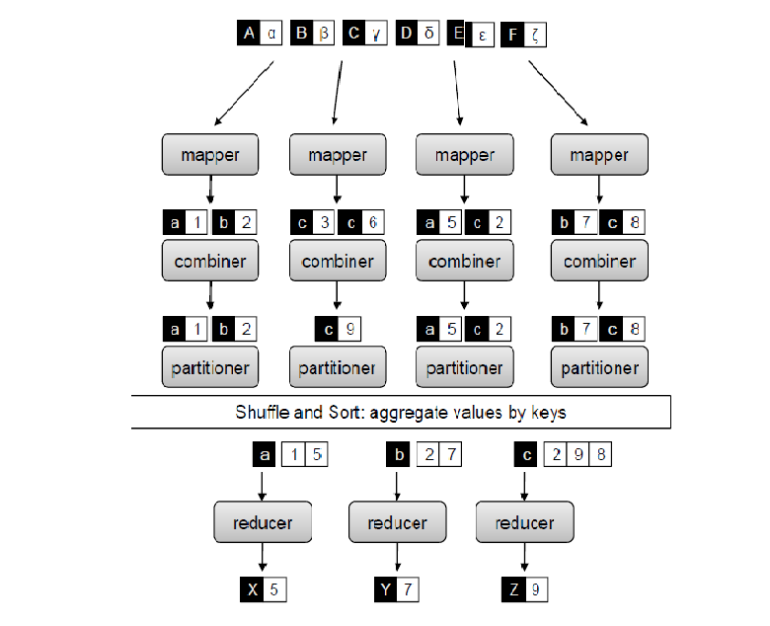

Slide 38
Job
A complete MapReduce job consists of code for the mapper, reducer, combiner, and partitioner, along with job conguration parameters. The execution framework handles everything else.

Slide 39
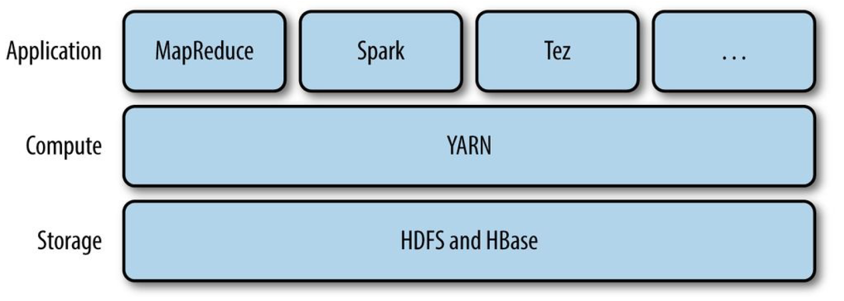
YARN
YARN(Yet Another Resource Negotiator) is one of the key features in Hadoop 2
Originally described by Apache as a redesigned resource manager, YARN is now characterized as a large-scale, distributed operating system for big data applications.

Slide 40
YARN
YARN is a software rewrite that decouples MapReduce's resource management and scheduling capabilities from the data processing component
  enabling Hadoop to support more varied processing approaches and a broader array of applications.
For example, Hadoop cluster can now run interactive querying and streaming data applications simultaneously with MapReduce batch jobs.
The original incarnation of Hadoop closely paired the Hadoop Distributed File System (HDFS) with the batch-oriented MapReduce programming framework, which handles resource management and job scheduling on Hadoop systems.

Slide 41
YARN
YARN combines a central resource manager that reconciles the way applications use Hadoop system resources with node manager agents that monitor the processing operations of individual cluster nodes.
Running on commodity hardware clusters, Hadoop has attracted particular interest as a staging area and data store for large volumes of structured and unstructured data intended for use in analytics applications.
Separating HDFS from MapReduce with YARN makes the Hadoop environment more suitable for operational applications that can't wait for batch jobs to finish.

Slide 42
Anatomy of a YARN Application Run
YARN provides its core services via two deamons:
  a resource manager (one per cluster) to manage the use of resources across the cluster
  node managers on all the nodes in the cluster to launch and monitor containers. A container executes application-specific process with constrained set of resources (RAM, CPU, etc.).
STEP 1: To run an application, a client contacts the resource manager and asks it to run an application master process.
STEP 2: The resource manager then finds a node manager that can launch an application master in a container

Slide 43
Anatomy of a YARN Application Run
Precisely what the application master does once it is running depends on the application. It could simply run a computation in the container it is running in and return the result to the client. Or, it could request more containers from the resource manager and use them to run a distributed computation (MapReduce does this).
http://ercoppa.github.io/HadoopInternals/AnatomyMapReduceJob.html

Slide 44
Scheduling in YARN
In an ideal world, the requests that a YARN application makes would be granted immediately.
In the real world, however, resources are limited, and on a busy cluster, an application will often need to wait to have some of its requests fulfilled.
Scheduling in general is a difficult problem and there is no one “best” policy, which is why YARN provides a choice of schedulers and configurable policies

Slide 45
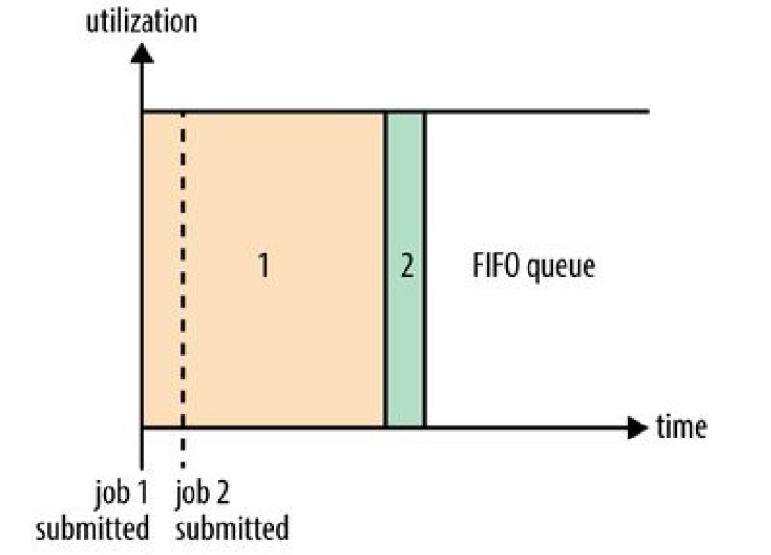
Scheduling in YARN
FIFO (first in, first out)
The FIFO Scheduler places applications in a queue and runs them in the order of submission.
Requests for the first application in the queue are allocated first; once its requests have been satisfied, the next application in the queue is served, and so on.

Slide 46
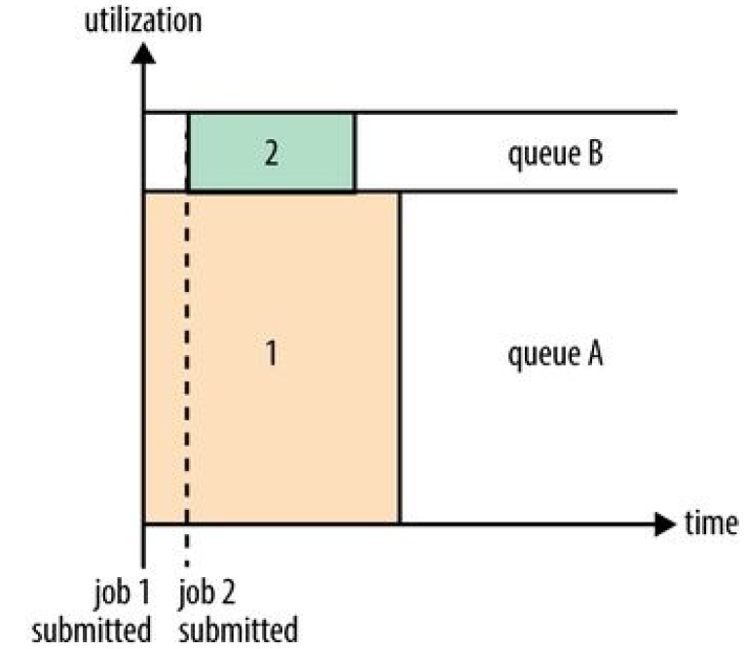
Scheduling in YARN
Capacity Scheduler
The Capacity Scheduler allows sharing of a Hadoop cluster along organizational lines, whereby each organization is allocated a certain capacity of the overall cluster.
Queues may be further divided in hierarchical fashion, allowing each organization to share its cluster allowance between different groups of users.
Within a queue, applications are scheduled using FIFO scheduling.

Slide 47
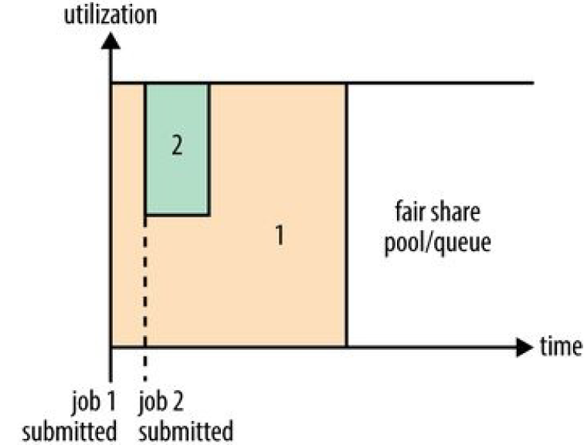
Scheduling in YARN
Fair Scheduler
The Fair Scheduler attempts to allocate resources so that all running applications get the same share of resources.
When job 1 is submitted, it is allocated all resources available.
Assume that job 2 is submitted while job 1 is running. After a while, each job is using half of the resources.
Job 1 is allocated full resources after job 2 finishes.

Slide 48
Hadoop 2
Hadoop 2 adds support for running non-batch applications through the introduction of YARN.
YARN puts resource management and job scheduling functions in a separate layer beneath the data processing one
  → enabling Hadoop 2 to run a variety of applications (big data analytics and other enterprise applications).
For example, it is now possible to run event processing as well as streaming, real-time and operational applications.
The capability to support programming frameworks other than MapReduce also means that Hadoop can serve as a platform for a wider variety of big data analytical applications.

Slide 49
Hadoop 2
Hadoop 2 also includes new features designed to improve system availability and scalability.
For example, it introduced an Hadoop Distributed File System (HDFS) high-availability (HA) feature that brings a new NameNode architecture to Hadoop:
  allows users to configure clusters with redundant NameNodes, removing the chance that a lone NameNode will become a single point of failure (SPoF) within a cluster.
  a new HDFS federation capability lets clusters be built out horizontally with multiple NameNodes that work independently but share a common data storage pool, offering better compute scaling as compared to Apache Hadoop 1.x.

Slide 50
MapReduce
In Hadoop, mappers are Java objects with a Map method (among others). A mapper object is instantiated for every map task by the tasktracker. The life-cycle of this object begins with instantiation, where a hook is provided in the API to run programmer-specified code.

